Slide 1
Search Algorithms: Object-Oriented Implementation (Part C)

Slide 2
Contents
Conventional vs. AI Algorithms
Local Search Algorithms
Implementing Hill-Climbing Algorithms
Defining ‘Problem’ Class // today’ topic (Part C-1)
Adding Gradient Descent // next week (Part C-2)
Defining ‘HillClimbing’ Class
Adding More Algorithms and Classes
Adding Genetic Algorithm
Experiments

Slide 3
Migrating into Classes
Part C-1
Class implementation

Slide 4
Implementing Class
Basic Idea
Convert the content saved in the numeric.py and tsp.py code into Numeric and Tsp classes, respectively.
If we convert the existing code as is into classes, Numeric Class and Tsp Class will contain functions that used for the following: 1) The problem to be solved, 2) The optimal solution, 3) Algorithm for finding the solution.
At this point, Numeric and Tsp Class commonly include variables for storing the optimal solution and functions for printing the solution to the screen.
Solution using Inheritance: Even if new types of problems and new kinds of solution algorithms are added in the future, the logic for storing the solution and printing the solution to the screen will be commonly used. Therefore, this common logic is separated to create a Problem class for managing the solution storage variables and output logic.
Then, generate subclasses (or child classes) like Numeric and Tsp by inheriting from the Problem class.

Slide 5
Implementing Class
Implementation approach
Top-Level Class : Problem (problem.py)
Implements variables and functions related to the solution.
Subclasses : Numeric, Tsp (same file alongside problem.py)
Inherit from the Problem class (inheriting solution-related variables/functions).
Implement variables for storing the Numeric/TSP problem itself.
Implement functions that are frequently/commonly used by solution algorithms for solving the Numeric/TSP problem.
Solution Algorithm Code: first-choice(n).py, first-choice(tsp).py, steepest ascent(n).py, steepest ascent(tsp).py
Includes the main function of the existing code.
Includes logic specialized for each solution algorithm.

Slide 6
Defining Classes
variables
problem.py source code define three classes
functions
Problem
solution
value
numEval
Numeric
Tsp
expression
domain
delta = 0.01
__init__
storeResult
report
numCities
locations
distanceTable
__init__
setVariables
getDelta (new)
randomInit
evaluate
mutants
mutate
randomMutant
describe
report
coordinate
__init__
setVariables
calcDistanceTable
randomInit
evaluate
mutants
inversion
randomMutant
describe
report
tenPerRow

Slide 7
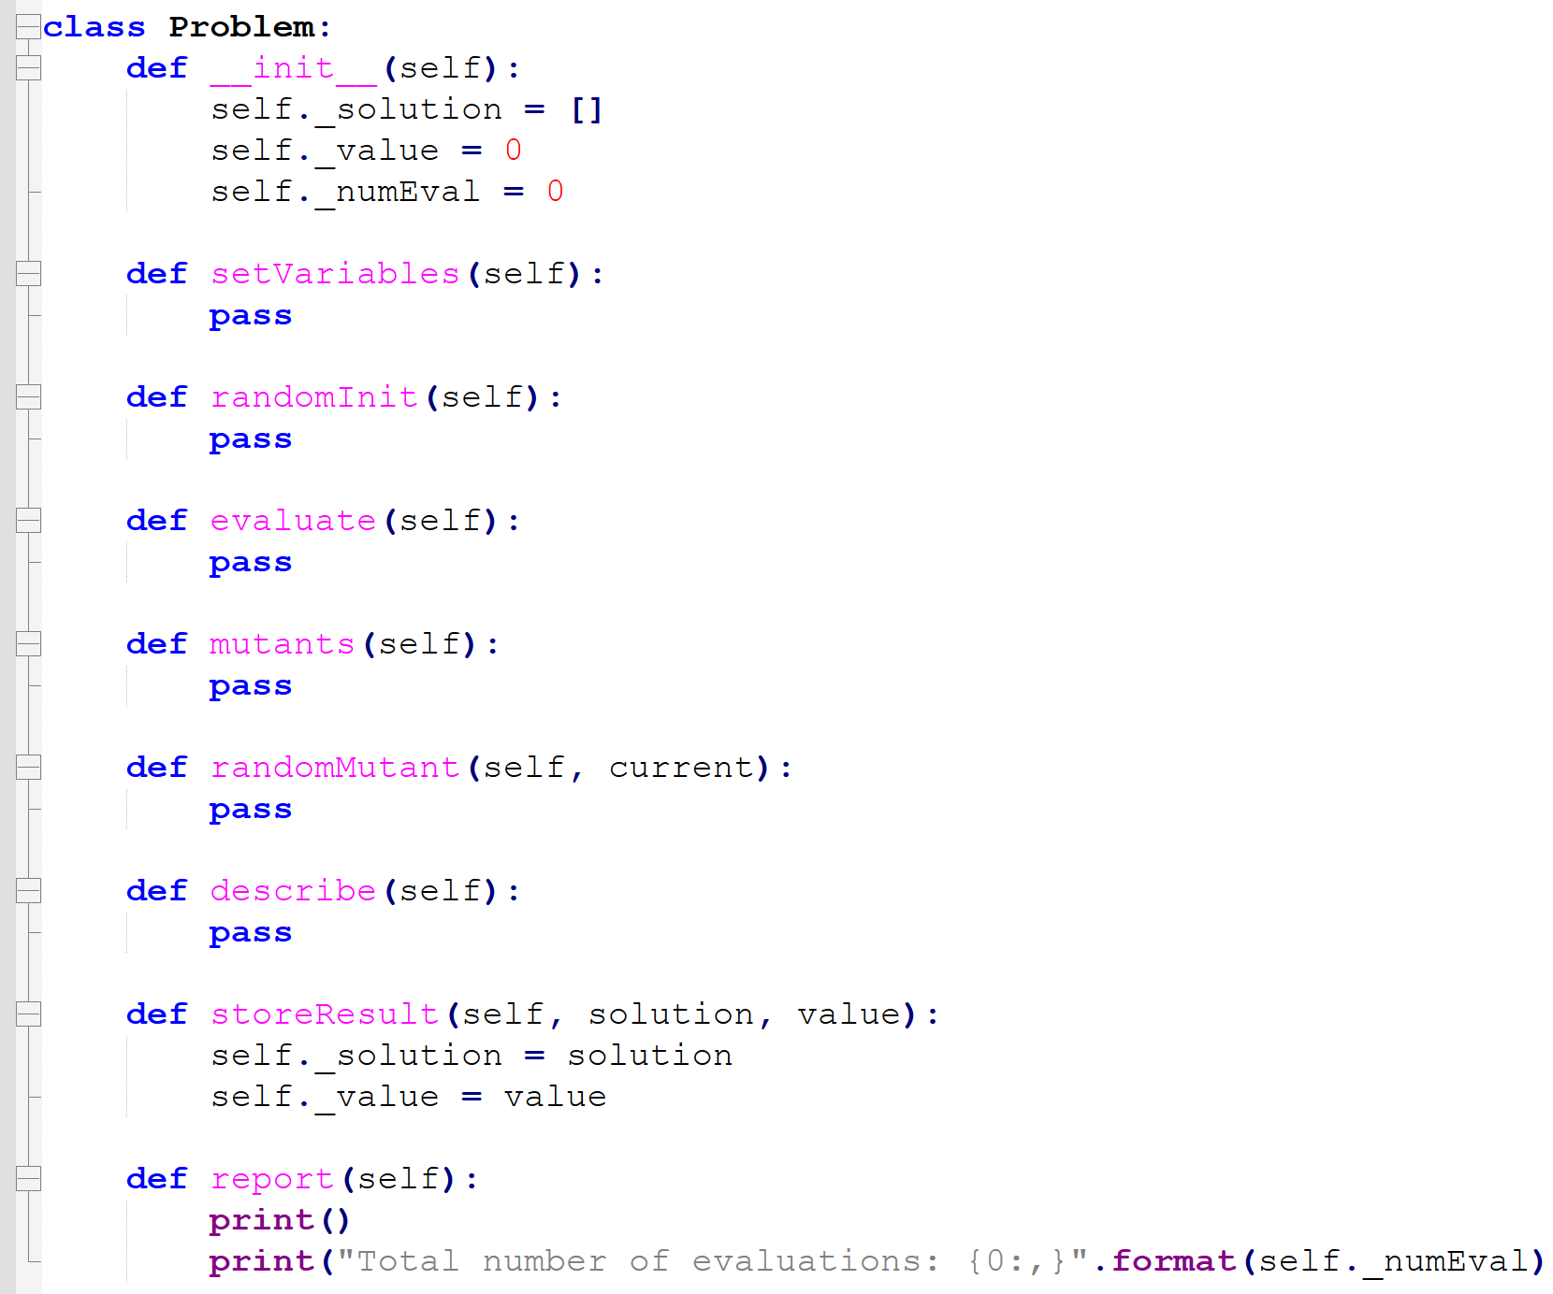
Defining Classes
However, the actual class implementation will include more methods than the diagram on the previous page.
Problem Class
Functions such as setVariables, randomInit, evaluate, mutants, randomMutant, and describe are methods that the Numeric and Tsp Subclasses must implement and use. Therefore, these methods are declared in the Problem class and left as placeholders (pass)
Subclasses (Numeric, Tsp) will actually implement the methods with method overriding

Slide 8
Defining Classes
However, the actual class implementation will include more methods than the diagram on the previous page.
Numeric Class
Since the Gradient Descent Algorithm will be added in the future, related methods are: gradient, takeStep, isLegal
Tsp Class
Almost identical to the existing tsp.py
Some of the previously used methods names were changed:
createProblem → setVariables
describeProblem → describe
displayResult → report

Slide 9
Defining Classes
Four source codes are used to implement and run the solution algorithms:
first-choice (n).py
steepest ascent (n).py
first-choice (tsp).py
steepest ascent (tsp).py
In addition, the following source code is added for the implementation of the Gradient Descent (GD) solution algorithm:
gradient descent.py
GD can only be applied to continuous variables, so it can only be used for Numeric Optimization problems and cannot be used for TSP problems.

Slide 10
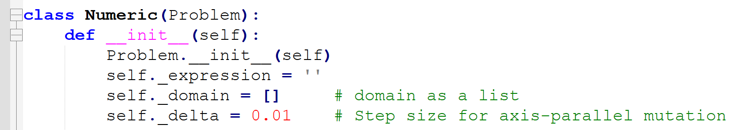
Defining Classes
The subclass Numeric has three variables for storing specifics about the problem:
expression: function expression of a numerical optimization problem
domain: lower and upper bounds of each variable of the function
delta: step size of axis-parallel mutation

Slide 11
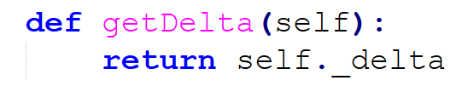
Defining Classes
The subclass Numeric has three variables for storing specifics about the problem:
delta takes the role of DELTA that was previously the named constant of the ‘numeric’ module
delta is referred to by mutants and randomMutant
Its value is preset to 0.01 for the time being for convenience
(getter method) The method getDelta is newly made for being used by the displaySetting function of the main program when displaying the value of delta

Slide 12
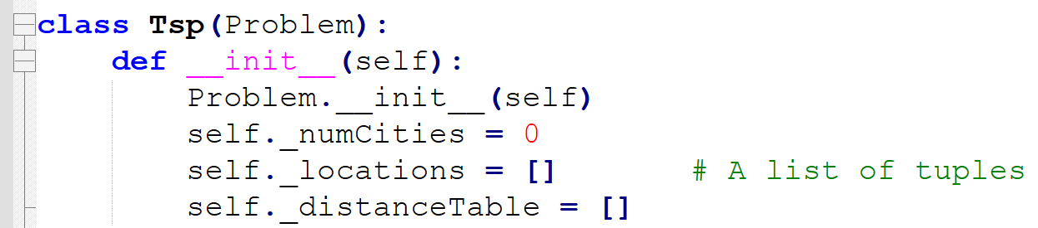
Defining Classes
The subclass Tsp also has three variables:
numCities: number of cities (N)
locations: coordinates of city locations in a 100 × 100 square
distanceTable: matrix of distances of every pair of cities (N-by-N)

Slide 13
Defining Classes
Both Numeric and Tsp have the setVariables method that reads in the specifics of the problem to be solved and stores them in the relevant class variables
It is renamed from its previous version createProblem
Unlike createProblem, setVariables does not return anything
Because problem-relation information is stored in the class member variables.

Slide 14
Defining Classes
Notice that the functions mutants and randomMutant can also be converted to methods of both Numeric and Tsp classes
mutants, randomMutant are declared in the Problem Class (as placeholders), but the actual implementation is performed in the Numeric and tsp classes.
mutants appears in both SAHC-N and SAHC-T
randomMutant appears in both FCHC-N and FCHC-T

Slide 15
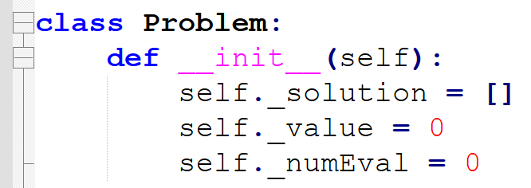
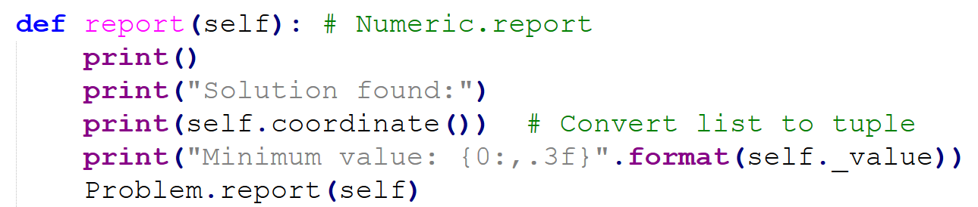
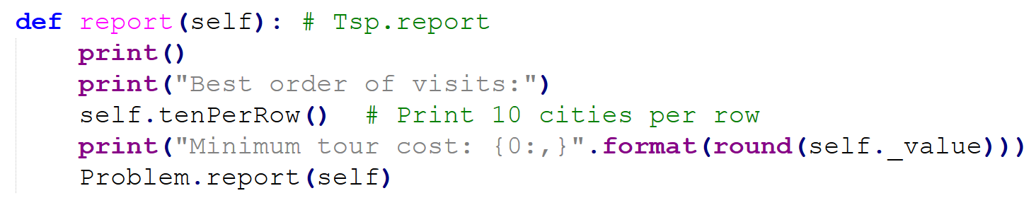
Defining Classes
The base class Problem has three variables for storing the result of search:
solution: final solution found by the search algorithm, x*
value: its objective value, f(x*)
numEval: total number of evaluations taken for the search
The values of solution and value are set by the storeResult method that is called by the search algorithms
Now the search algorithms do not have the return statement
But, the way to report the optimal solution differs depending on the problem type.
The common solusion report of Problem.report are shared between Numeric.report and Tsp.report with slight changes for respective problem.

Slide 16
Defining Classes
report (previously displayResult) is defined in both the base class and the subclasses
report in the base class prints numEval that is a common information to both the subclasses
The one in the base case handles general information and is inherited to the subclasses
report in each subclass prints further information specific to the problem type
To call a method of a superclass, it should be stated explicitly (e.g., Problem.report(self))
We can see that object-oriented programming provides us with the opportunity to organize codes in a way easier to maintain

Slide 17
Defining Classes
The value of numEval is initially 0 and incremented whenever the evaluate method is called
Previously, reporting the value of the global variable NumEval was done by displayResult of both ‘numeric’ and ‘tsp’ modules
But, NumEval appeared in duplicate in both modules and thus, printing numEval is done by the Problem.report method now

Slide 18
Defining Classes
Numeric and Tsp have many methods of the same names but with different implementations (declared in Problem, implemented in Numeric and TSP)
Polymorphism allows us to write codes that look the same regardless of the type of problem to be solved
E.g., evaluate of Numeric and evaluate of TSP are of the same name but are implemented differently depending on the type of problem to be solved (numerical optimization or TSP)
By introducing the classes and taking advantage of polymorphism, we will eventually be able to unite the main programs of different search algorithms into a single program
Duplications among different main programs can be avoided

Slide 19
Defining Classes
We store Problem class in a separate file named ‘problem.py’
‘random.py’ and ‘math.py’ that were imported to the previous modules should now be imported to the ‘problem.py’ file
Each main program needs to import either Numeric or Tsp from the ‘problem.py’ file
ex) from problem import Numeric
ex) from problem import Tsp

Slide 20
Changes to the Main Program
To execute different solution algorithms for each problem type, we use the corresponding Python code files:
first-choice (n).py
first-choice (tsp).py
steepest ascent (n).py
steepest ascent (tsp).py
(later on, gradient descent.py)
Each code file is simplified and contains only the following content:
main function // Runs the algorithm from the file, executes the algorithm and display result.
Core algorithm implementation// Logics specialized for that algorithm.
Function that prints the setting values// Setting values for that algorithm.

Slide 21
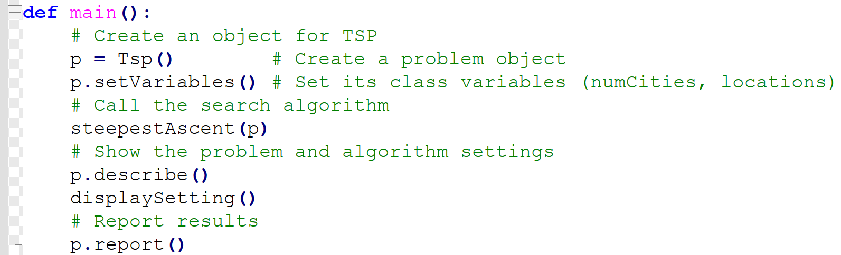
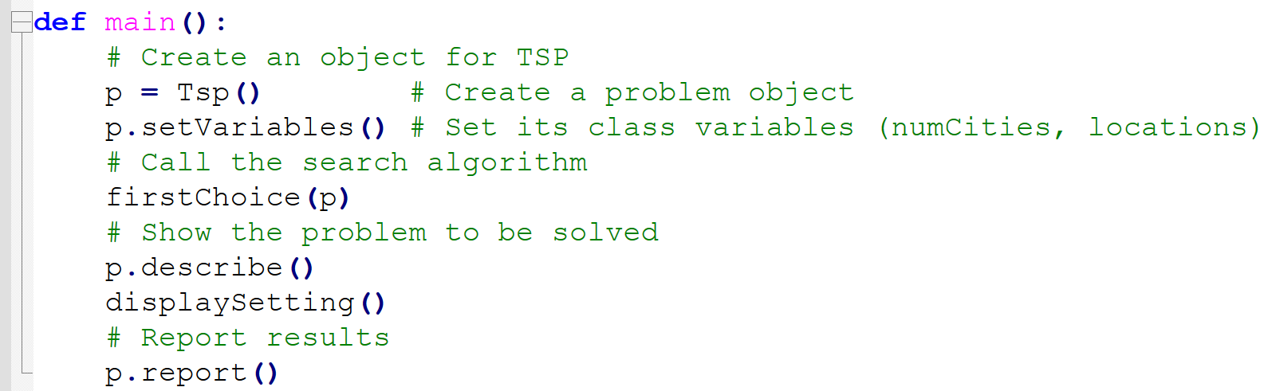
Code outside of problem.py
steepest ascent(tsp).py
first-choice(tsp).py
def main():
p = Tsp()
...
def steepestAscent(p):
...
def bestOf(neighbors,p):
...
def displaySetting():
...
main()
def main():
p = Tsp()
...
def firstChoice(p):
...
def displaySetting():
...
main()

Slide 22
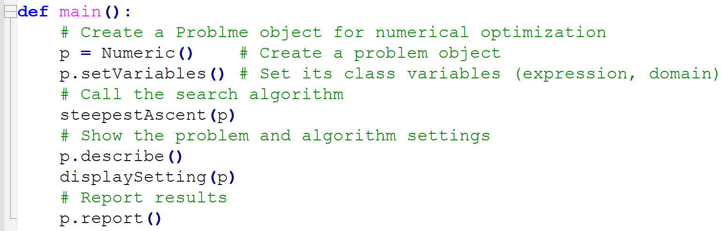
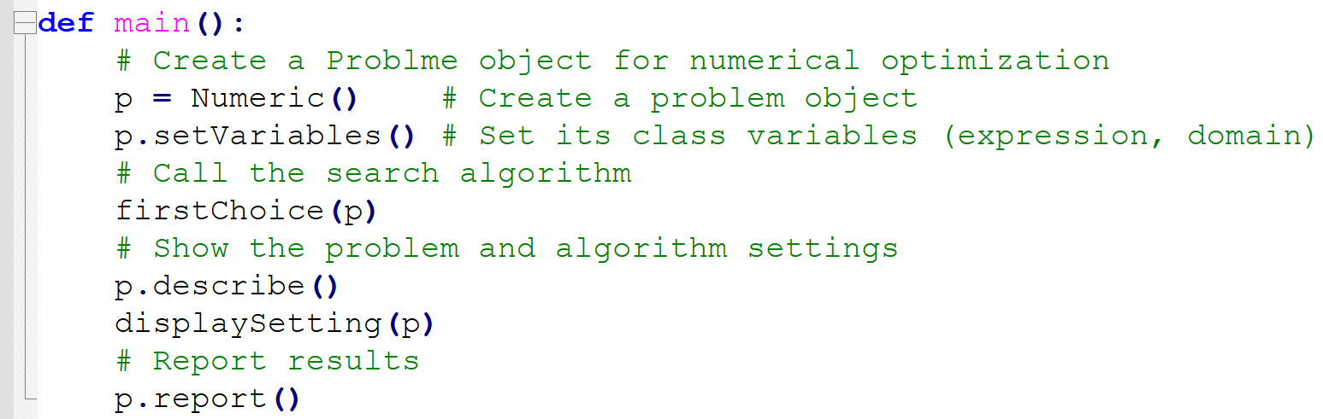
Code outside of problem.py
steepest ascent(n).py
first-choice(n).py
def main():
p = Numeric()
...
def steepestAscent(p):
...
def bestOf(neighbors,p):
...
def displaySetting(p):
...
main()
def main():
p = Numeric()
...
def firstChoice(p):
...
def displaySetting(p):
...
main()

Slide 23
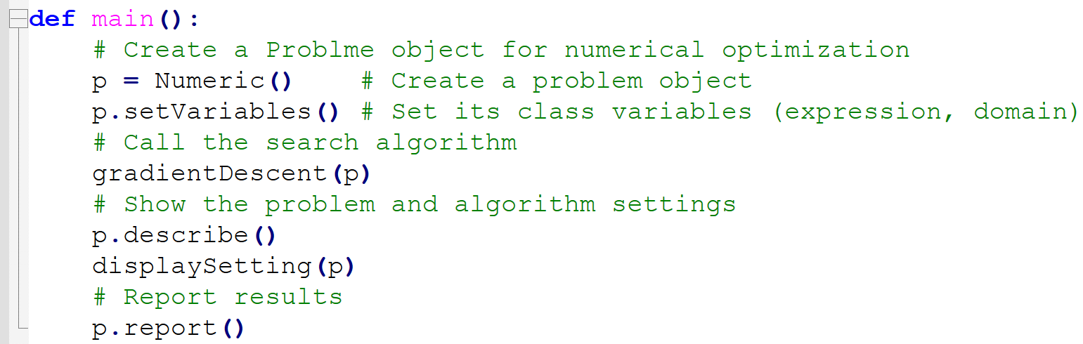
Code outside of problem.py
gradient descent.py
def main():
p = Numeric()
...
def gradientDescent(p):
...
def displaySetting(p):
...
main()
Next lecture topic

Slide 24
Changes to the Main Program
It is the main function that creates an instance of Problem object (p = Numeric() or p = Tsp())
Then, the setVariables method (p.setVariables) is executed to store the problem-related values in the relevant class variables
Stores problem-related information in the class member variables.
Previously this was done by the function createProblem (function name changed)
ex) Steepest Ascent for Numeric Optimization

Slide 25
Changes to the Main Program
After creating problem p, the main function calls the search algorithm with p as its argument
The search algorithm calls the methods such as randomInit, evaluate, and mutants to conduct the search and these methods refer to the relevant class variables when executed
ex) Steepest Ascent for Numeric Optimization
The source code implementing each algorithm is an independent function (e.g., steepestAscent) that receives the class instance p as an argument.

Slide 26
Changes to the Main Program
After running the search algorithm, the main function makes calls to relevant methods
to show the specifics of the problem solved (p.describe),
to display the settings of the search algorithm (displaySetting),
and then to display the result (p.report)
ex) Steepest Ascent for Numeric Optimization

Slide 27
Changes to the Main Program
There were two versions of mutants for the steepest-ascent hill climbing: one for numeric optimization and the other for TSPs
They are now migrated to the Numeric and Tsp classes
Similarly, randomMutant of the first-choice hill climbing are migrated to the Numeric and Tsp classes, too
The functions displaySetting and bestOf still remain in the main program because they are tied with the search algorithms used rather than the types of the problems solved

Slide 28
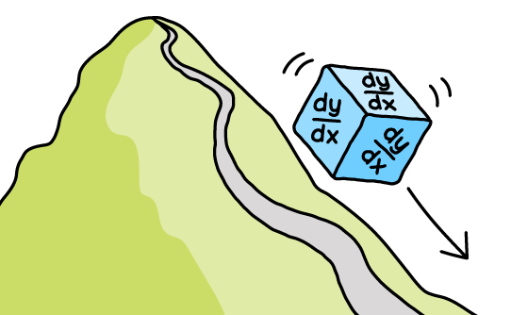
Gradient Descent Algo.
Part C-2
Next
Solution for solving continuous variable problems

